Slide 1
Farmer assistance portal
Group Members – Abhishek Badal (210943120003)
Amit Singh (21094312012)
Ankit Sharma (21094312013)
Mehul Kunte (21094312048)
Project Guide – Mrs. Harshita Maheshwari

Slide 2
Contents
Introduction
Choice of topic
Proposed System
Methodology
Proposed System Model
Proposed Approach
Screenshot
System Requirements
Applications
Advantages & Limitations
Conclusion
Future Scopes
References

Slide 3
Introduction
Farmer assistance portal is a web application to help farmers as well as customers.
This application allows a good communication.
It provides admin, buyer, farmer and Expert login.
Dealers can publish advertisements.
Farmers & admin can add different products.

Slide 4
Choice of topic
Through this project farmers ensure great profitability.
Easy & Fast
Advertisement Page
Product Differentiation

Slide 5
Proposed System
AIM:
1. It will help farmers
Proposed System:
1. Digitalize Agriculture
2. Communication can take place even through mobile
3. Eliminate Intermediates

Slide 6
Methodology
The objective is to create a web site that can perform the following:-
Connecting to an HTTPS site through GPRS/WIFI.
Opening the relevant HTML page using HTTPS POST & GET methods.
Read the data logically into farmer, supplier and admin.
Creating a local database.

Slide 7
Proposed System Model
There are three main modules:
Admin Farmer Buyer
1 Home 1 Home 1 Home
2 Product Category 2 Product Category 2 All Product
3 All Products 3 All Products 3 Questions
4 Add Products & Banner 4 Add Products & Banner 4 Notification
5 Log Out 5 Log Out 5 Log Out

Slide 8
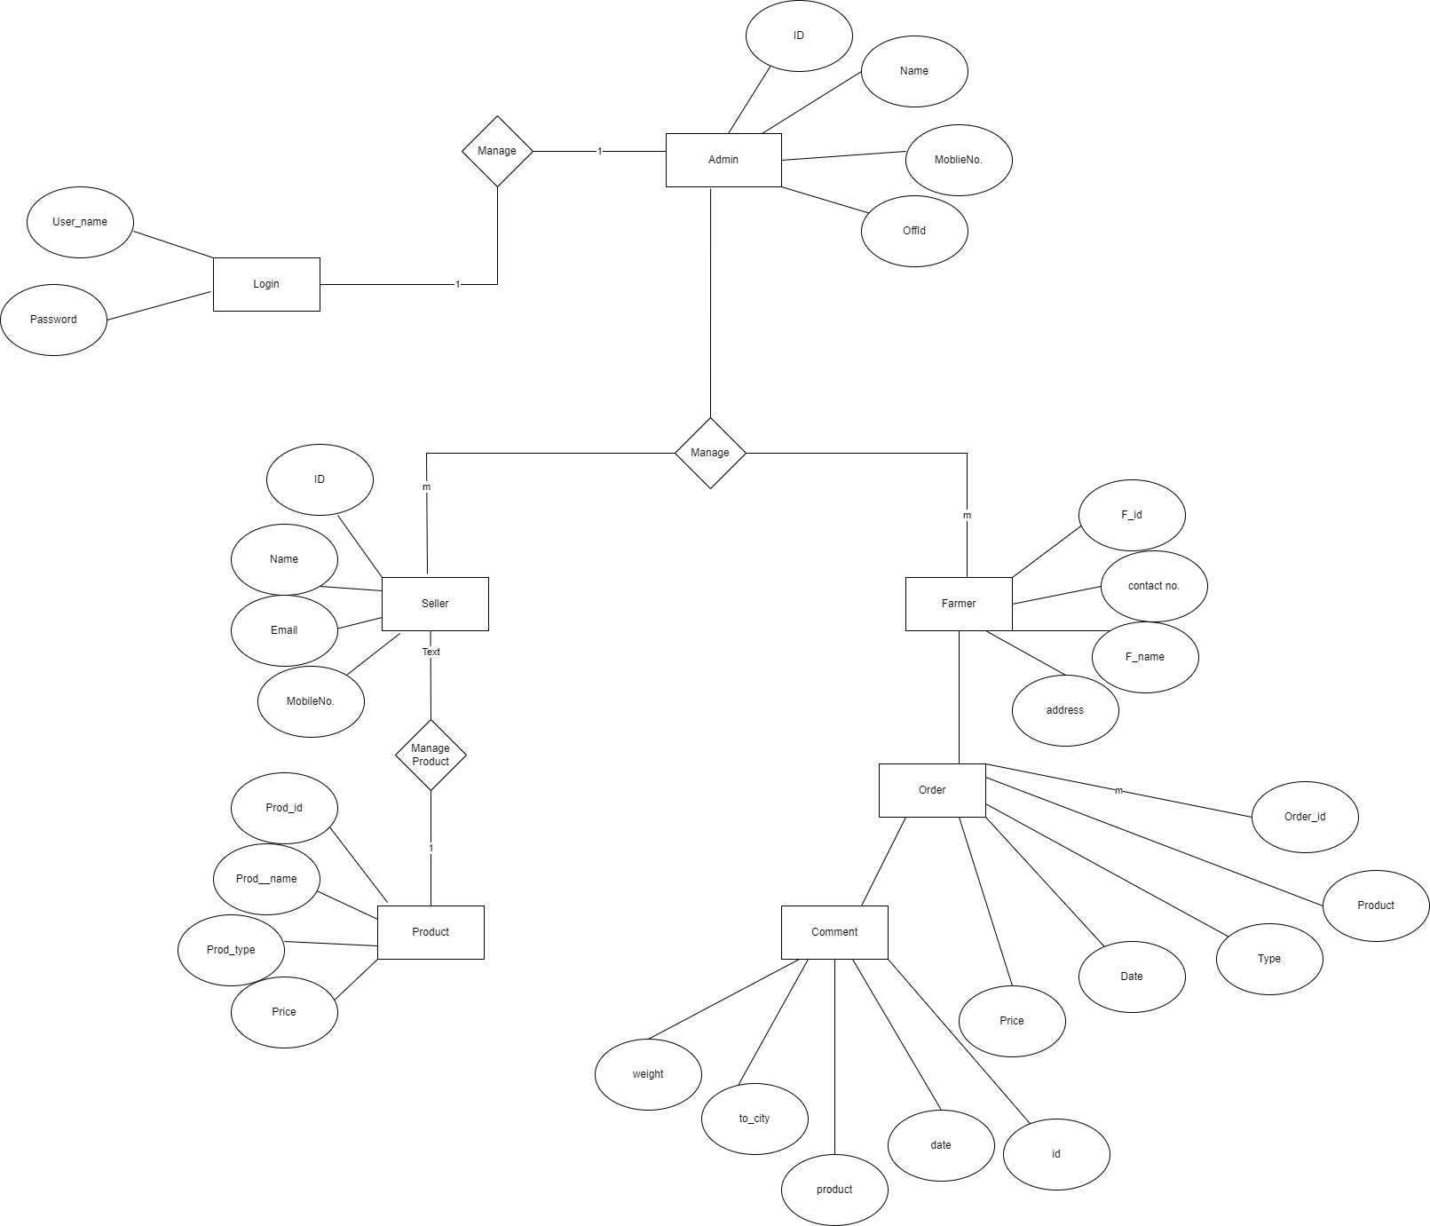
Proposed Approach

Slide 9
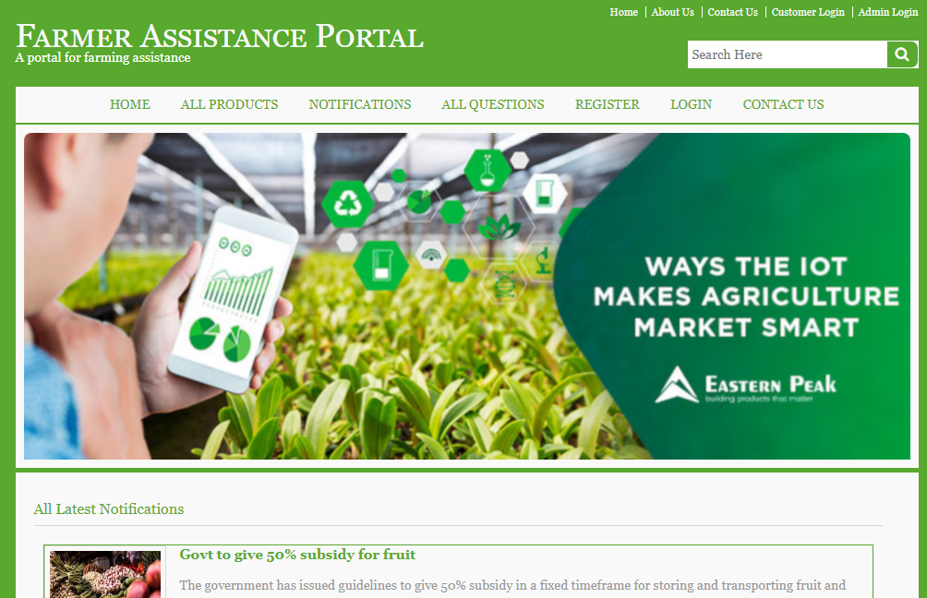
Screenshots

Slide 10
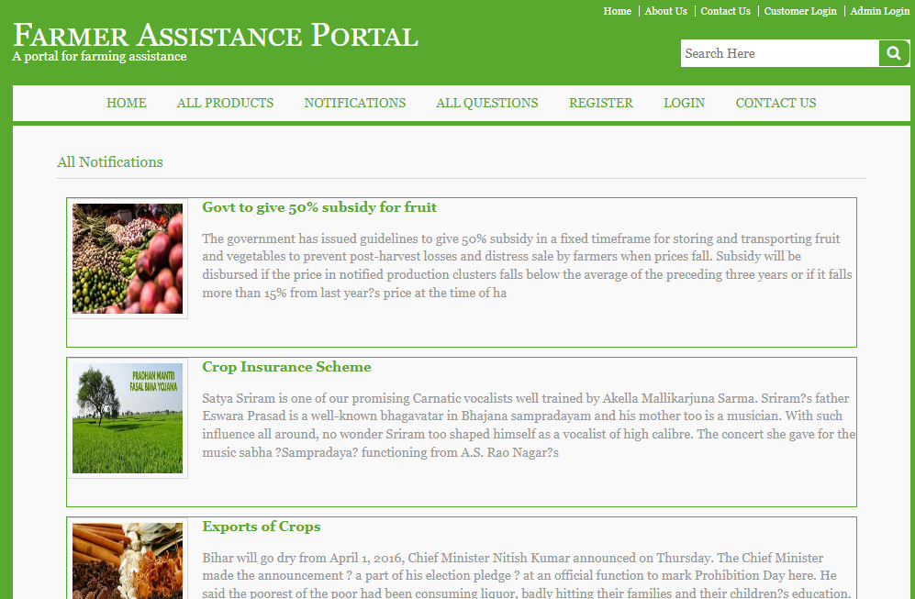

Slide 11
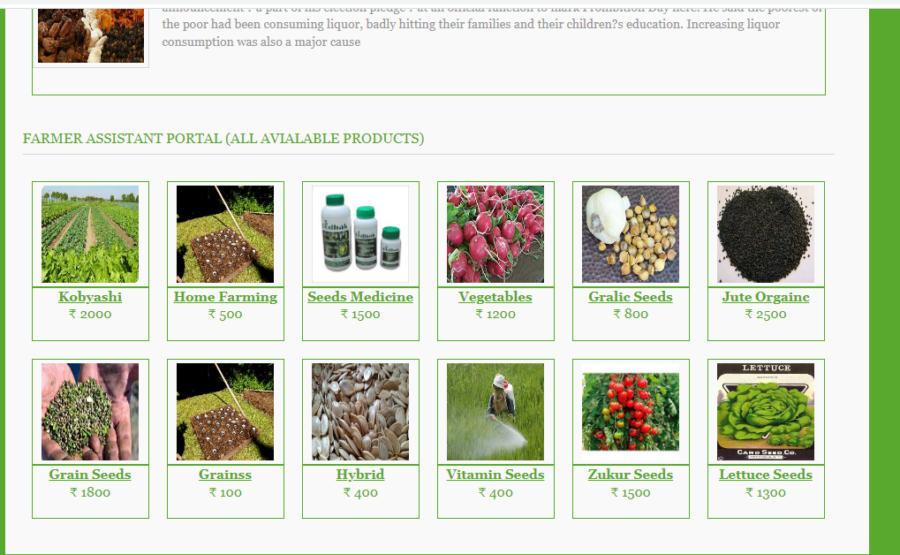

Slide 12
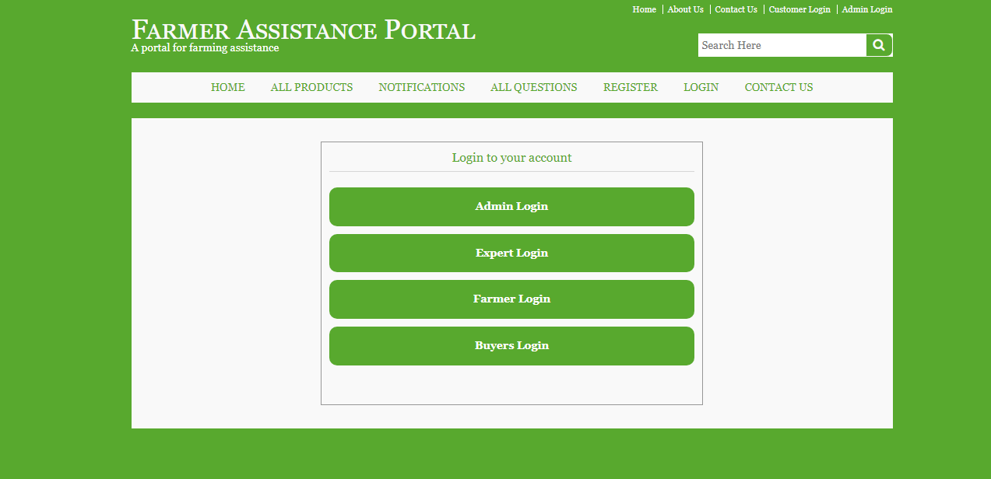

Slide 13
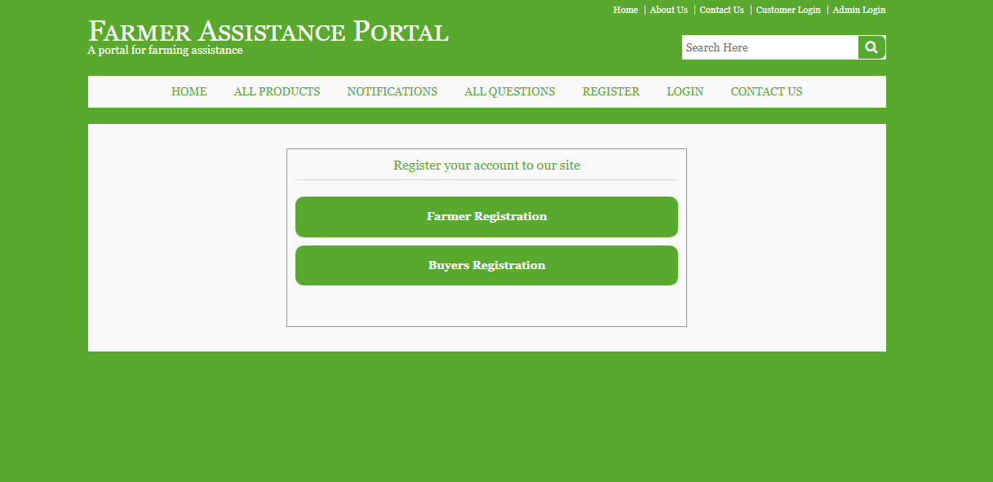

Slide 14
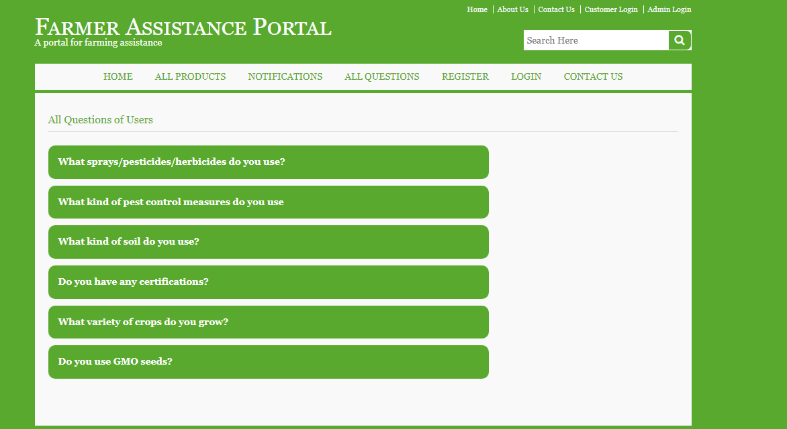

Slide 15
System Requirements
Software Requirements:
• Windows (All Versions)
• Tomcat 9
• Eclipse, MySQL, XAMMP
Hardware Components:
• Processor – i3
• Hard Disk – 5 GB
• Memory – 1GB RAM

Slide 16
Technologies Used
HTML : Page Layout has been designed in HTML.
CSS : Used for all designing part.
JavaScript : All Validation task and animations has been developed by JS.
JSP : All front end logic has been written in JSP.
JAVA : All the business logic has been written in JAVA.
MySQL : MySQL database has been used as database.
Tomcat : Project will run using Tomcat server.

Slide 17
Applications
Digital Farming
Can be used in other countries
Agricultural Industry

Slide 18
Advantages
Transparency in the system.
Saves Time, cost and energy.
Farmers can submit their grievances online.
They can get notifications of any new offers.

Slide 19
Limitations
Accurate verification of the users cannot be done online.
It requires an extensive database and memory.

Slide 20
Conclusion
The farming assistance web service will be designed and developed to overcome the drawbacks of old manual system and meet the requirement of modern age. This system will digitalize the agriculture industry and give more profit to farmers. It will bring transparency between farmers, suppliers and buyers by removing intermediates. It will save time & energy of everyone using this portal. Lastly it can be improved in future according to rising demand of users.

Slide 21
Future Scope
Verification of users.
Improvement in design.
Mobile Application
UPI payment
Integration of new function like farmers can rent equipment according to their need
Chat BOT

Slide 22
References
Mr. Saleel Bagde for Database.
Mrs. Harshita Maheshwari for HTML JS & CSS also she was our project guide.
Mr. Raju Kolhe for JSP & JAVA.
https://www.slideshare.net
https://www.projectideas.co.in
Europol report, 2016
International Conference on I2C2, 2017
A special thanks to Infoway Management who arranged extra lab time for us.

Slide 23
THANK YOU

